Slide 1
Design Patterns
This lecture is included in your hourly

Slide 2
5 Minute Quiz

Slide 3
What are Design patterns?
Design patterns are generalized solutions to generalized problems that occur with some modicum of frequency when you're creating software using the object oriented programming paradigm. *reference: Design Patterns in Game Programming by Michael Haney (https://www.gamasutra.com/blogs/MichaelHaney/20110920/90250/Design_Patterns_in_Game_Programming.php)

Slide 4
Designing in OOP
Designing object-oriented software is hard,
and designing reusable object-oriented software is even harder.

Slide 5
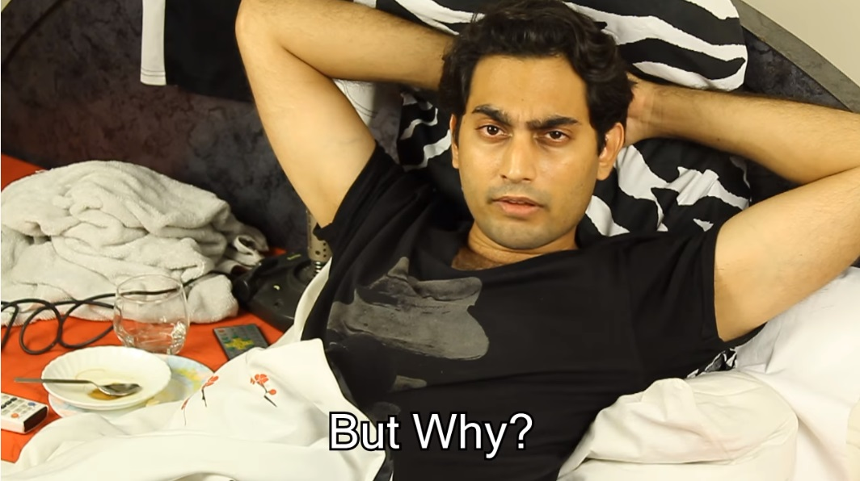
But Why?

Slide 6
But Why?
You must find pertinent objects,
factor them into classes at the right granularity,
define class interfaces and inheritance hierarchies,
and establish key relationships among them.

Slide 7
What a good design should be
Your design should be specific to the problem at hand but also general enough to address future problems and requirements.
You also want to avoid redesign, or at least minimize it.
Experienced object-oriented designers will tell you that a reusable and flexible design is difficult if not impossible to get "right" the first time.
Before a design is finished, they usually try to reuse it several times, modifying it each time.
It takes a long time for novices to learn what good object-oriented design is all about. As long as you keep trying, you will be OK!

Slide 8
Why use design patterns?
These solutions have existed for a relatively long time and many experts have used them.
They are likely better than any solution you could come up with on your own.
Knowledge of contextually pertinent design patterns helps you to make good architecture and design decisions.

Slide 9
A Design Pattern
In general, a pattern has four essential elements:
The pattern name is a handle we can use to describe a design problem, its solutions, and consequences in a word or two.
The problem describes when to apply the pattern. It explains the problem and its context.
The solution describes the elements that make up the design, their relationships, responsibilities, and collaborations. The solution doesn't describe a particular concrete design or implementation, because a pattern is like a template that can be applied in many different situations.
The consequences are the results and trade-offs of applying the pattern. They are critical for evaluating design alternatives and for understanding the costs and benefits of applying the pattern

Slide 10
Types of Design Patterns
Creational
Structural
Behavioral

Slide 11
White-box reuse
Class inheritance lets you define the implementation of one class in terms of another's. Reuse by sub-classing is often referred to as white-box reuse.
The term “white-box” refers to visibility: With inheritance, the internals of parent classes are often visible to subclasses.

Slide 12
Black-box reuse
Object composition is an alternative to class inheritance. Here, new functionality is obtained by assembling or composing objects to get more complex functionality.
Object composition requires that the objects being composed have well-defined interfaces.
This style of reuse is called black-box reuse, because no internal details of objects are visible. Objects appear only as "black boxes."

Slide 13
Advantages of Inheritance
Class inheritance is defined statically at compile-time and is straightforward to use, since it's supported directly by the programming language.
Class inheritance also makes it easier to modify the implementation being reused.
When a subclass overrides some but not all operations, it can affect the operations it inherits as well, assuming they call the overridden operations.

Slide 14
Disadvantages of Inheritance
You can't change the implementations inherited from parent classes at run-time, because inheritance is defined at compile-time.
Parent classes often define at least part of their subclasses' physical representation. Because inheritance exposes a subclass to details of its parent's implementation, it's often said that “inheritance breaks encapsulation”.
The implementation of a subclass becomes so bound up with the implementation of its parent class that any change in the parent's implementation will force the subclass to change.

Slide 15
Advantages of Object Composition
Object composition is defined dynamically at run-time through objects acquiring references to other objects.
Because objects are accessed solely through their interfaces, we don't break encapsulation. Any object can be replaced at run-time by another as long as it has the same type.
Moreover, because an object's implementation will be written in terms of object interfaces, there are substantially fewer implementation dependencies.
Favoring object composition over class inheritance helps you keep each class encapsulated and focused on one task

Slide 16
Disadvantages of Object Composition
A design based on object composition will have more objects (if fewer classes)
The system's behavior will depend on their interrelationships instead of being defined in one class.

Slide 17
Two Principles of OOP Design
Program to an interface, not an implementation.
Favor object composition over class inheritance.

Slide 18
Delegation
In delegation, two objects are involved in handling a request: a receiving object delegates operations to its delegate.
This is analogous to subclasses deferring requests to parent classes.
Delegation is an extreme example of object composition. It shows that you can always replace inheritance with object composition as a mechanism for code reuse.

Slide 19
Delegation
Window
Rectangle
+ Area()
-rect
+ Area(): int
+ Info(): String
length: int
Width: int
Please write code in java that satisfies this design (Take 10 minutes)

Slide 20
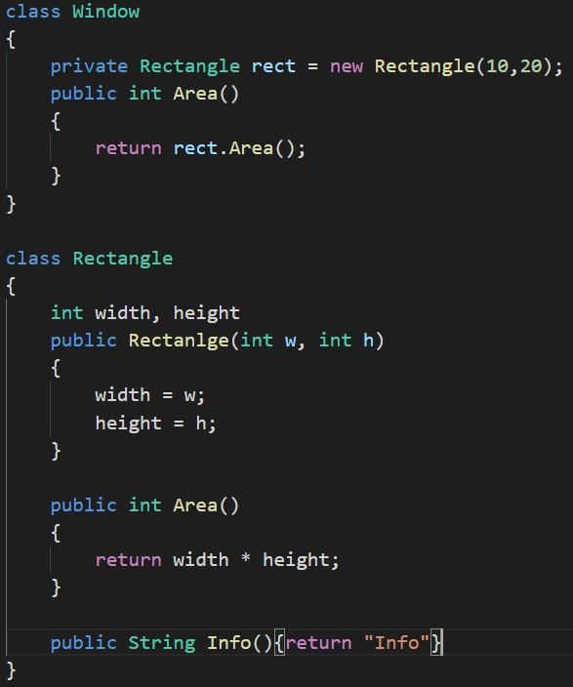

Slide 21
How will you design this?
Window
Rectangle
+ Area()
-rect
+ Area(): int
+ Info():String
length: int
Width: int
Take 5 minutes to decide

Slide 22
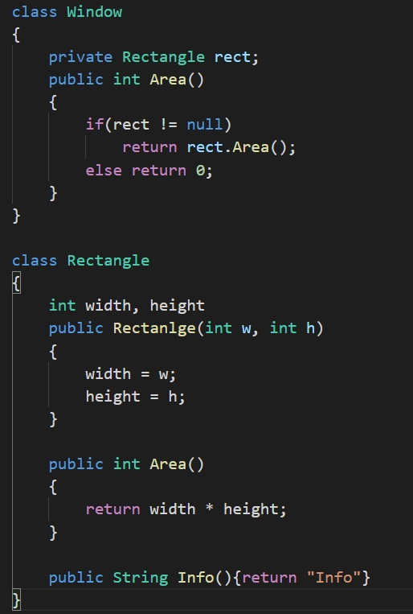

Slide 23
Pros and Cons
At any point in time I can change the object being referred and get a different result
Since this happens at run-time and is dynamic, it is a slower process
It however provides a lot of flexibility

Slide 24
Parameterized Types
Another (not strictly object-oriented) technique for reusing functionality is through parameterized types, also known as generics and templates.
This technique lets you define a type without specifying all the other types it uses. The unspecified types are supplied as parameters at the point of use.
For example, to declare a list of integers, you supply the type “integer” as a parameter to the List parameterized type.

Slide 25
Inheritance, Composition and Parameterized Types
Parameterized types give us a third way (in addition to class inheritance and object composition) to compose behavior in object-oriented systems.
Many designs can be implemented using any of these three techniques.

Slide 26
Inheritance, Composition and Parameterized Types
Object composition lets you change the behavior being composed at run-time, but it also requires indirection and can be less efficient.
Inheritance lets you provide default implementations for operations and lets subclasses override them.
Parameterized types let you change the types that a class can use.
But neither inheritance nor parameterized types can change at run-time. Hence what you end up using depends on your design.

Slide 27
Aggregation and Association
It's easy to confuse aggregation and association, because they are often implemented in the same way.
Aggregation and Association are implemented with pointers and references. They are determined more by intent than by explicit language mechanisms.
Aggregation relationships tend to be fewer and more permanent than Association.
Associations, in contrast, are made and remade more frequently, sometimes existing only for the duration of an operation.
Association are more dynamic as well, making them more difficult to discern in the source code.

Slide 28
Designing for Change
The key to maximizing reuse lies in anticipating new requirements and changes to existing requirements, and in designing your systems so that they can evolve accordingly.
To design the system so that it's robust to such changes, you must consider how the system might need to change over its lifetime.
Those changes might involve class redefinition and reimplementation, client modification, and retesting.
Redesign affects many parts of the software system, and unanticipated changes are invariably expensive.
Design patterns help you avoid this by ensuring that a system can change in specific ways.

Slide 29
How to use a Design Pattern?
Read the pattern once through for an overview. Pay particular attention to the Applicability and Consequences sections to ensure the pattern is right for your problem.
Go back and study the Structure, Participants, and Collaborations sections. Make sure you understand the classes and objects in the pattern and how they relate to one another.
Look at the Sample Code section to see a concrete example of the pattern in code.
Choose names for pattern participants that are meaningful in the application context
Define the classes. Declare their interfaces, establish their inheritance relationships, and define the instance variables that represent data and object references.

Slide 30
Factory (Creational Design Pattern)
It creates objects for you rather than you explicitly calling to make an object

Slide 31
Implementation
Define an Interface or an abstract class for creating an object but let the subclasses decide which class to initiate

Slide 32
UML
ToyFactory
Toy
+ CreateToy(t: int): Toy
creates
+ CreateParts(): void
+ AssembleParts(): void
Car
Plane
Ship
+ CreateParts(): void
+ AssembleParts(): void
+ CreateParts(): void
+ AssembleParts(): void
+ CreateParts(): void
+ AssembleParts(): void
Write your own Java code. Take 15 mins

Slide 33
Advantages
Less code change if we change the object creation process.
We create object without exposing the creation logic to the client.
We get object creation at runtime.

